Slide 1

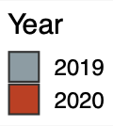
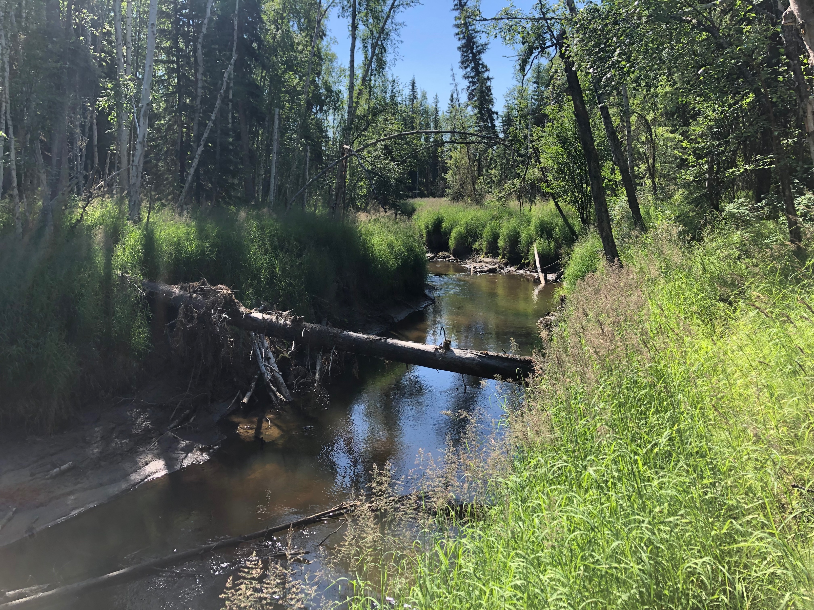
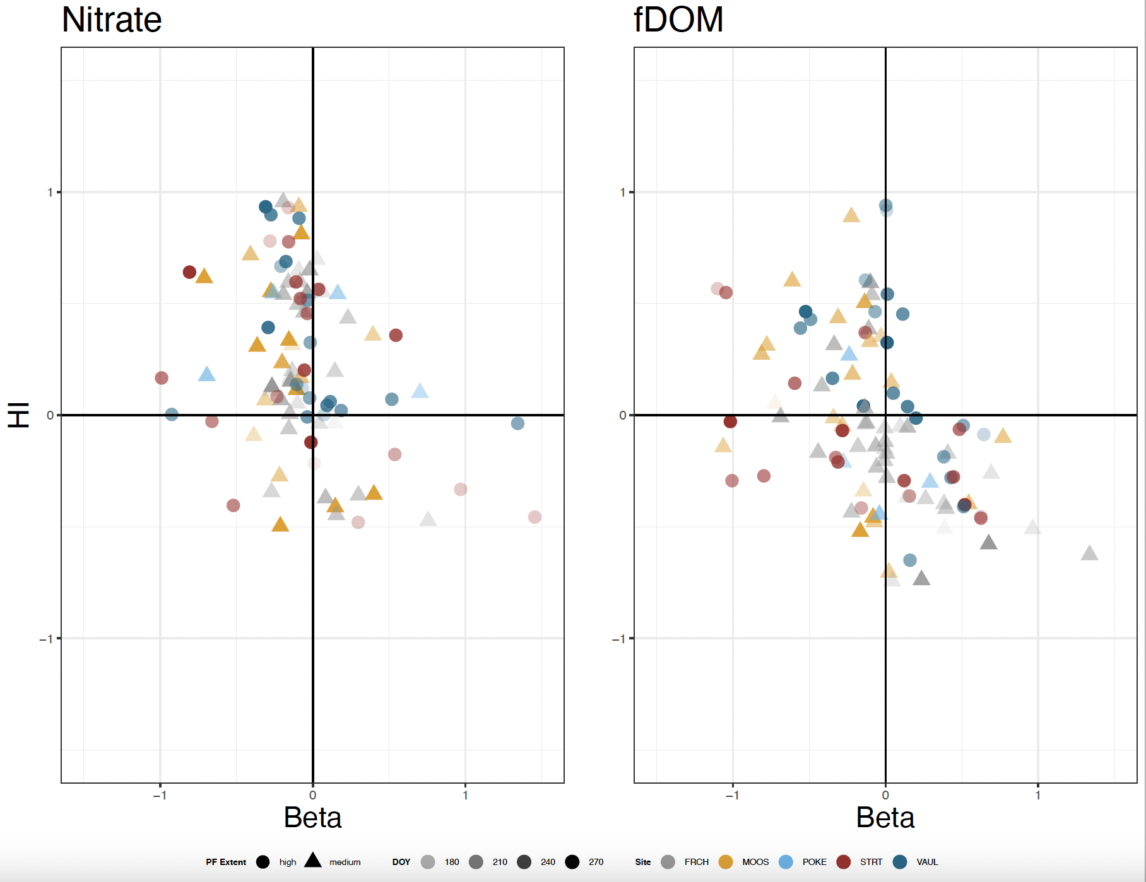
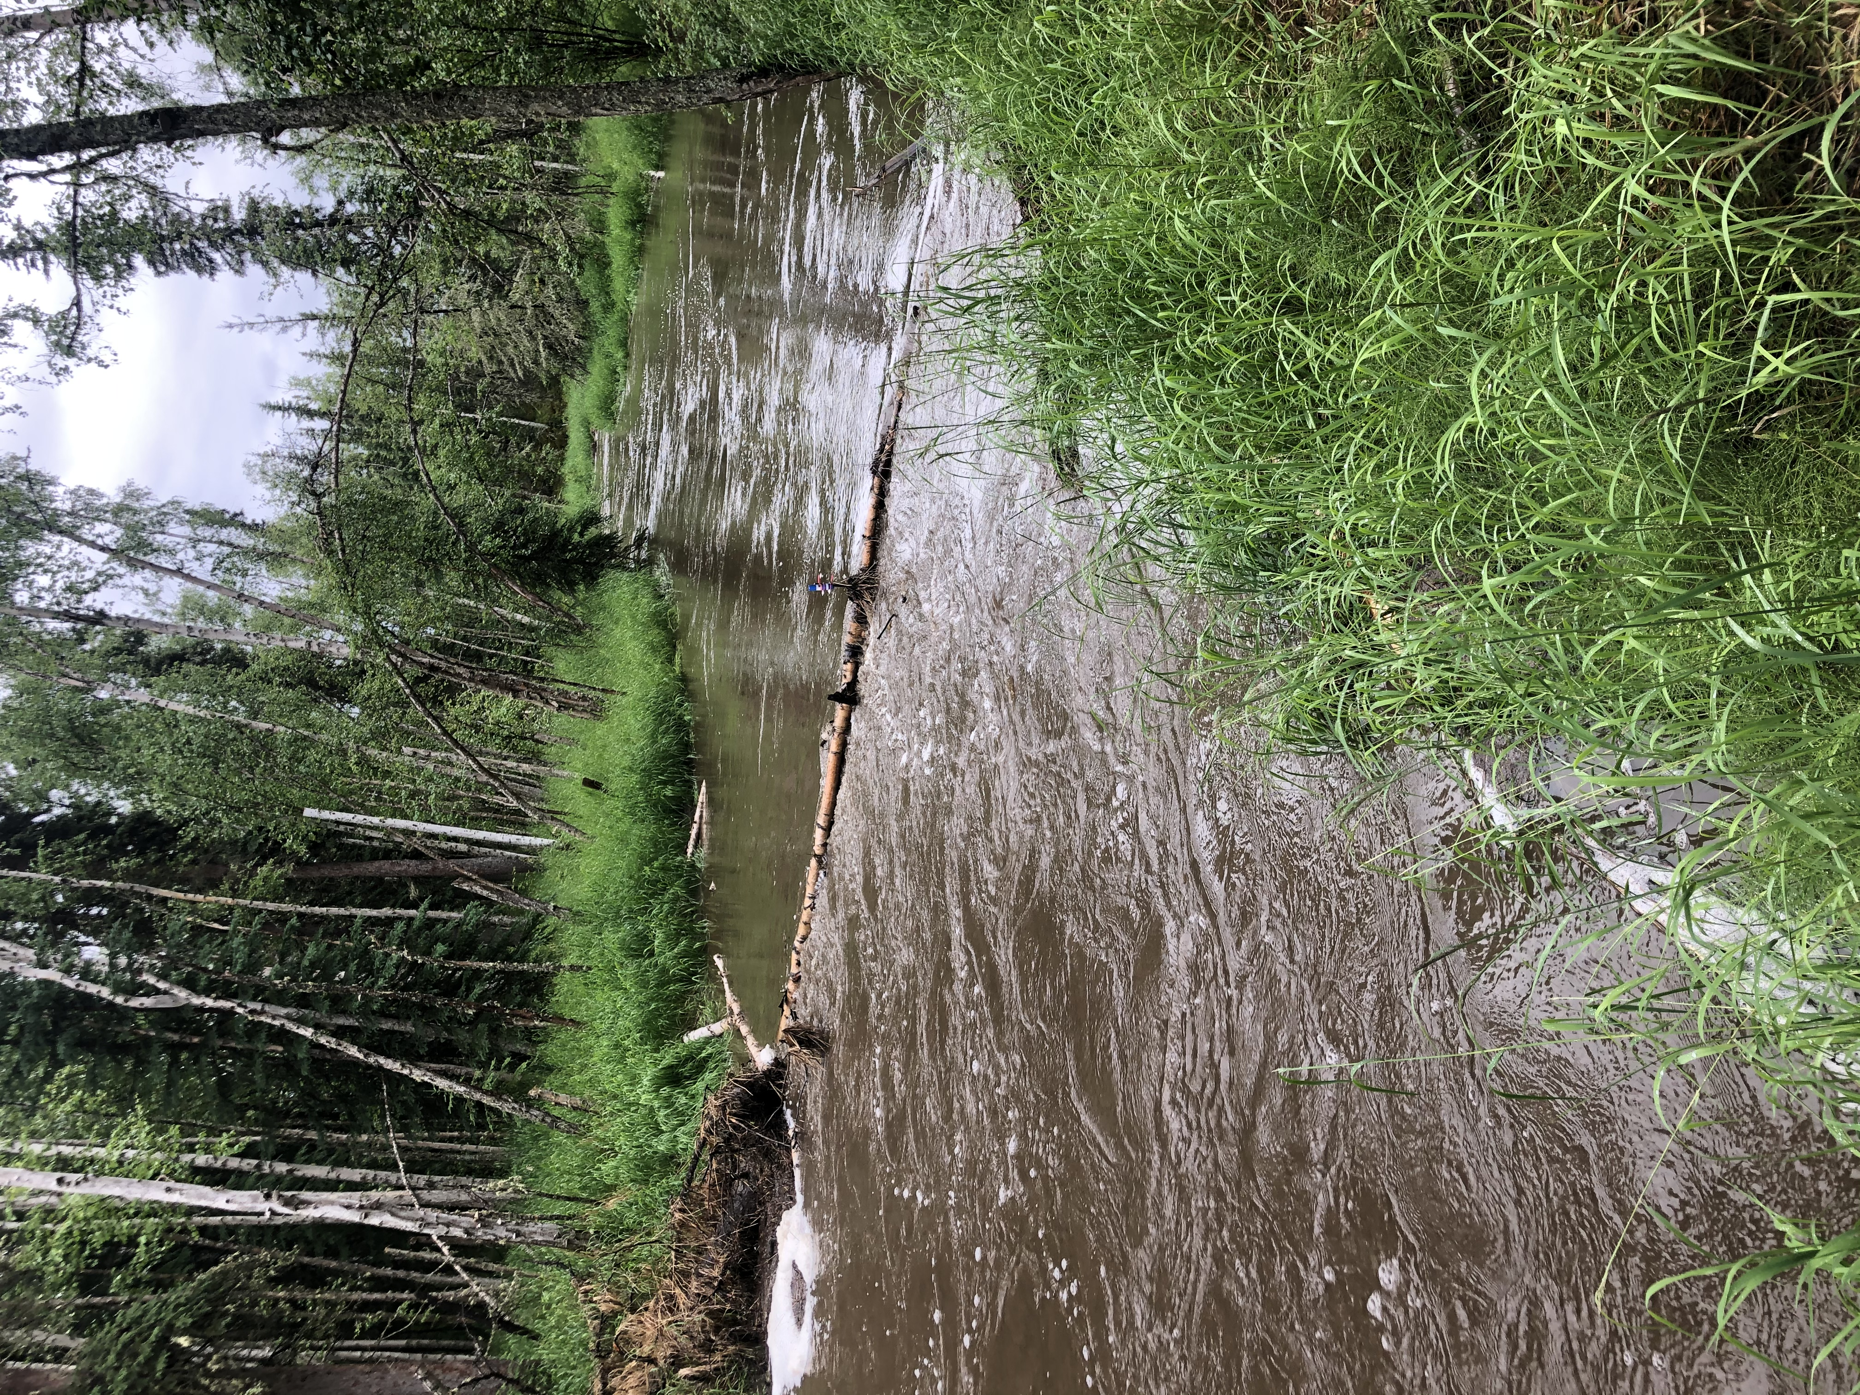


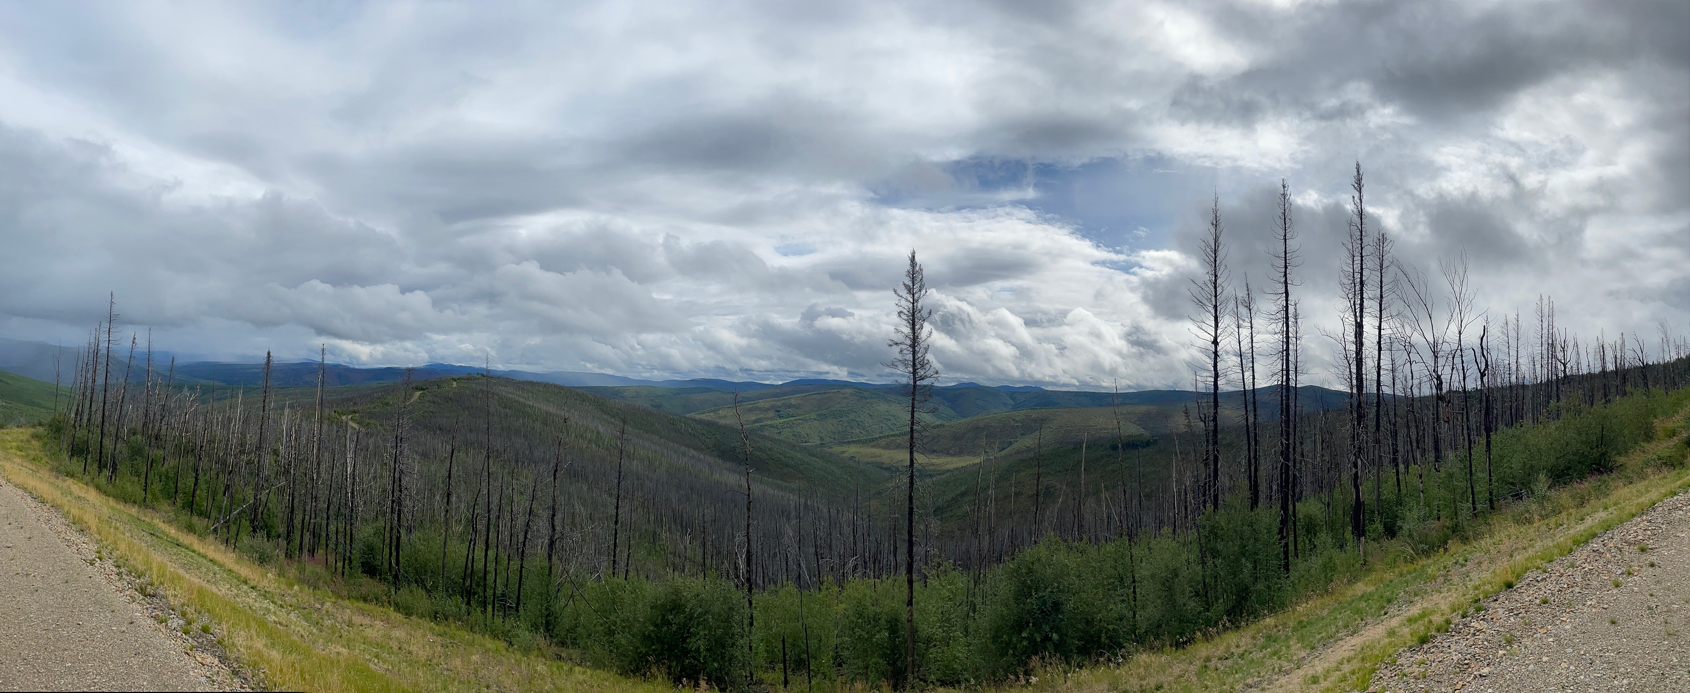
B45J-1750
Role of Antecedent Moisture Conditions on High-Latitude Biogeochemistry
Jake S. Cavaiani¹, Tamara K. Harms¹
¹Department of Biology and Wildlife and Institute of Arctic Biology, University of Alaska Fairbanks
How does increased temporal variability in precipitation alter catchment biogeochemistry in High-latitude catchments?
Stream solute concentrations and discharge across 2019 and 2020
The relationship between stream discharge and solute export in high-latitude catchments is dependent on antecedent moisture conditions
Increases in rainfall is correlated with increases in active layer depth and permafrost thaw
High precipitation years have a lasting influence on active layer depth
Hydrologic flowpaths shift from shallow organic rich soils to deeper, mineral rich soils, reducing dissolved organic matter (DOM) export and increasing concentrations of nitrate (NO₃⁻)
Hypothesis: Precipitation promotes solute uptake and leaching, thereby reducing solute storage within catchments and potential for subsequent export
Poker Creek (low PF extent) displays sustained elevated concentration of NO₃⁻ triggered by storm events
Stuart Creek (high PF extent) displays flushing of fDOM during storms
)
French Moose Poker Stuart Vault
f
Mod PF
Mod PF
Low PF
High PF
High PF
HI correlates with antecedent conditions rather than storm characteristics
Total precipitation is increasing
Increasingly temporal variability in precipitation
Stream concentrations of NO₃⁻ , fDOM, SPC, and Turbidity were not significantly different from 2019 and 2020
fDOM
NO₃⁻
High-frequency stream chemistry monitoring
R² =0.11
R² =0.14
Storm characteristics such as total storm precipitation and intensity do not correlate with HI
Antecedent moisture conditions on varying temporal scales across catchments correlate with HI
Increased export of nitrate and fDOM into streams could influence primary productivity
In situ sensors collecting fluorescent dissolved organic matter (fDOM, proxy for dissolved organic carbon) and nitrate (NO₃⁻) concentrations in 2019-2020 in boreal catchments at 15 minute intervals
Sites consisted of varying permafrost extent, fire history and aspect
North-facing slopes are dominated by black spruce whereas south and west-facing slopes are dominated by mixed hardwoods
French Moose Poker Stuart Vault
Mod PF
Mod PF
Low PF
High PF
High PF
Hysteresis and Beta Indices
R² =0.01
R² =0.23
Hysteresis: Differences in the concentration-discharge relationship between the rising and falling limbs of a storm indicating transport vs. storage limitation
Beta: C-Q slope of the rising limb to indicate flushing or dilution
Little evidence of storm-scale patterns across PF extent for fDOM
Switch from flushing to diluting throughout the season for NO₃⁻
R² =0.35
R² =0.04
R² =0.06
R² =0.29
R² =0.01
R² =0.22
Fairbanks
Above: Moose Creek (mod PF extent) during baseflow and during storm event
Fig 4. Hysteresis index versus flushing index of A) NO₃⁻ B) fDOM c) SPC D) Turbidity with shape representing permafrost spatial extent(high vs. medium), color representing site, and transparency representing day of year (darker is later in the year)
High permafrost experienced primarily a diluting effect for fDOM
Low permafrost catchments experienced primarily diluting for NO₃⁻
Acknowledments: Thomas Douglas, Jeffrey Falke, Laura Knutsen, Justin Hill, Kate Broberg, Dragos Vas, Tricia Nelsen, Lauren Bosche and Steph Saari contributed to sample collection and analysis. Research was supported by the Bonanza Creek Long-Term Ecological Research program (funded jointly by NSF grant DEB-1026415 and USDA Forest Service, Pacific Northwest Research Station grant PNW01-JV-11261952-231 and Development Program of the Department of Defense (RC-2507)
Above: Satellite imagery of our 5 study sites
Jcavaiani@Alaska.edu

